Slide 1
COPADS
IFEOLUWATAYO IGE
#1B – Programming C#

Slide 2
Outline
Classes
Namespaces
Implicitly typed variables
Accessing files
Exception Handling
Networking
Sample Demo codes

Slide 3
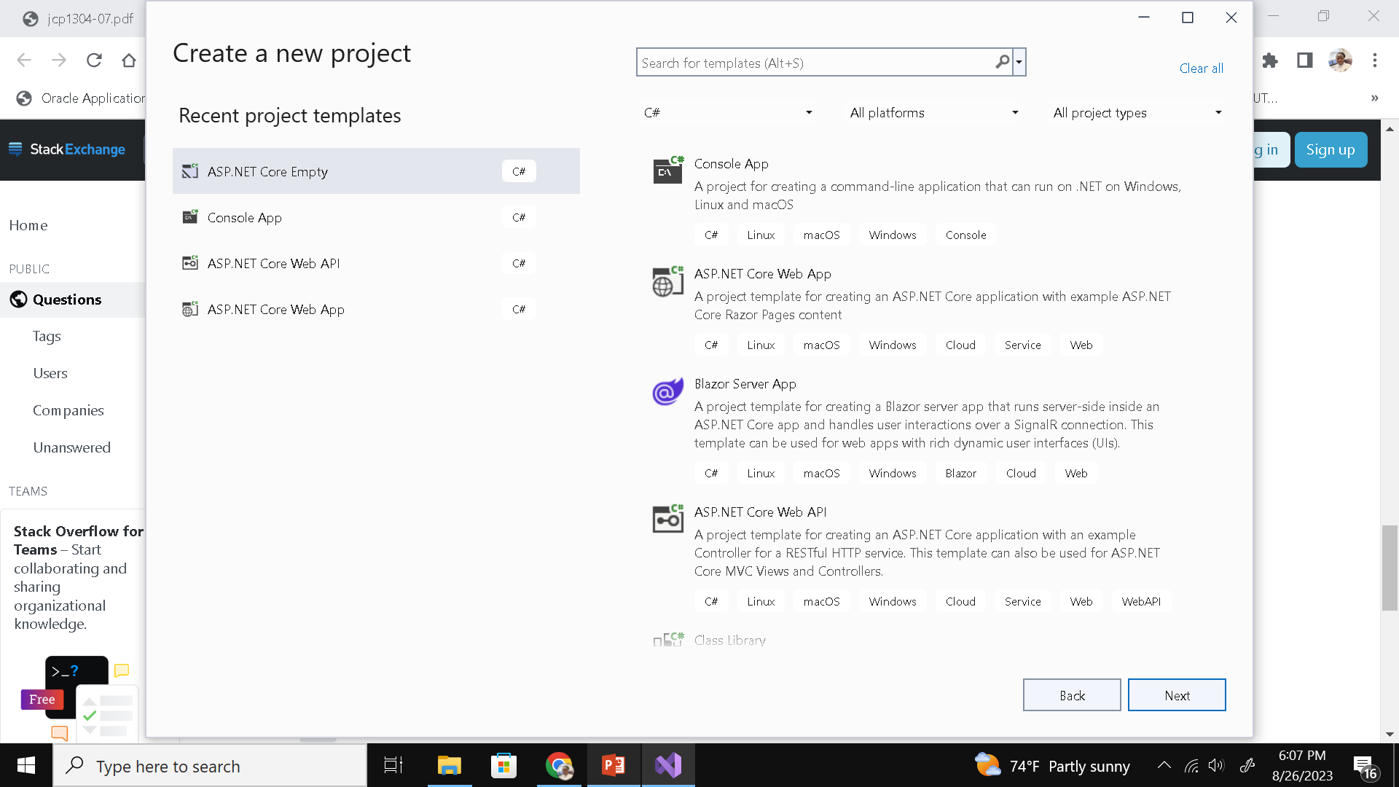
Basics of C#
can be used to develop a window-based, web-based, or console application.
For COPADS, only console and web-based applications will be developed based on the course syllabus.

Slide 4
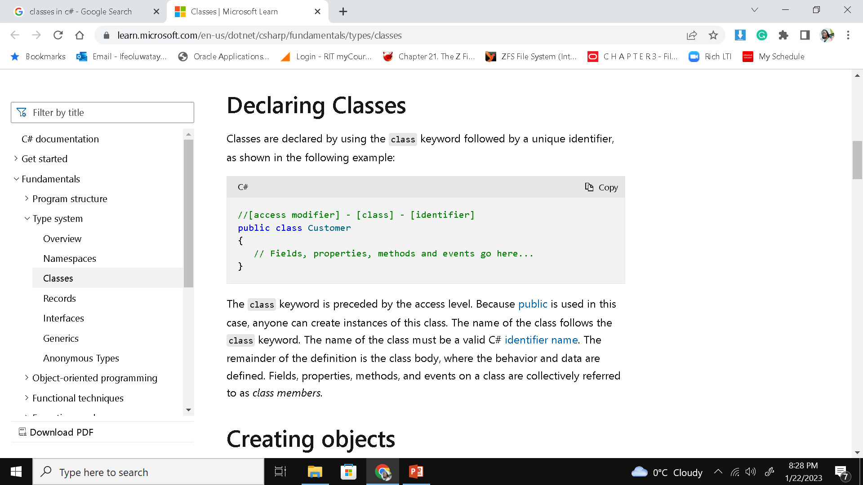
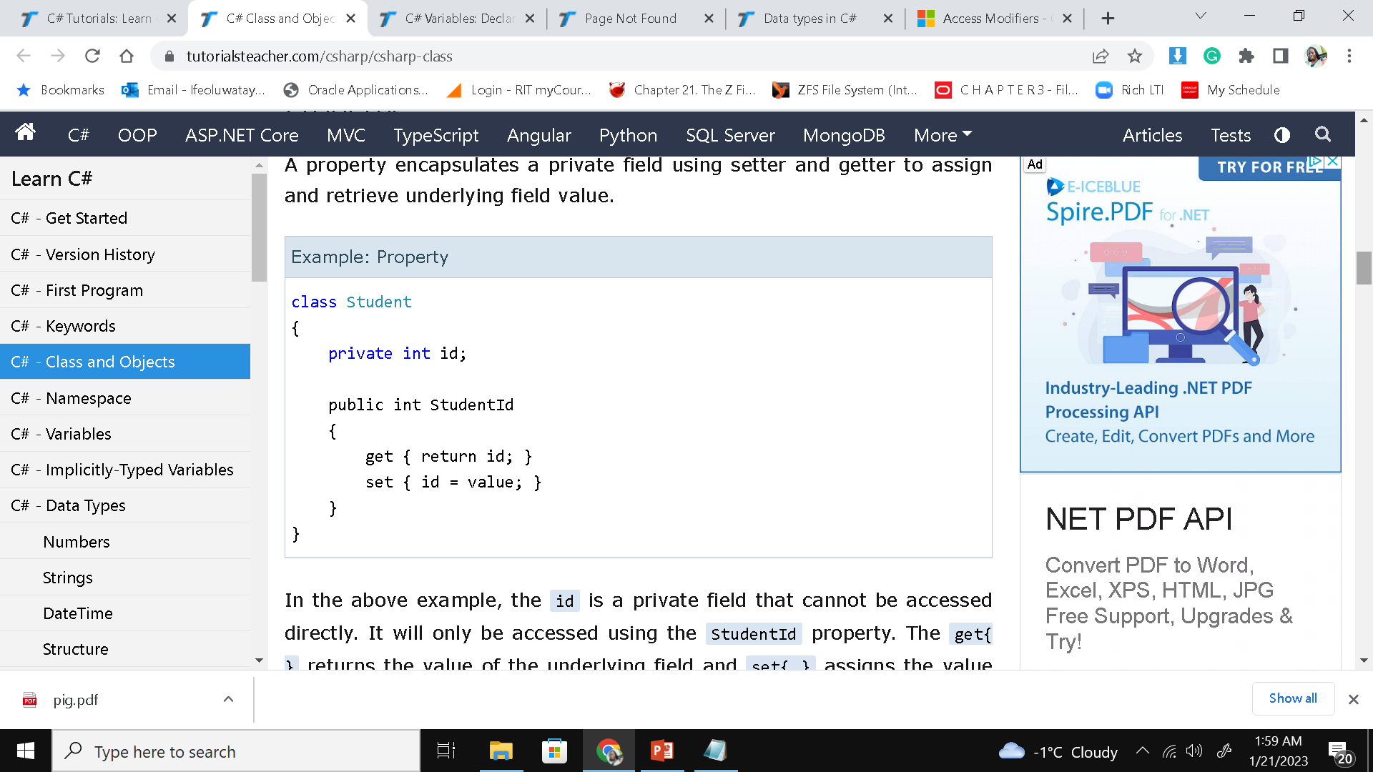
Declaring Classes in C#
Classes combine fields and methods into a single unit. A class could have one or all the following:
Access Modifiers can be either:
Private – only accessible within the same class
Public-accessible for all classes
Protected–accessible within the same class and derived classes
(inheritance)
Methods-
with void or return value
could have parameters
Field (s)- Fields could also have access modifiers.
A field may have a private access modifier used with a property. A property encapsulates a private field using a setter and getter to assign and retrieve an underlying field value
the id is a private field that cannot be accessed directly.
It will only be accessed using the StudentId property.
get{ } returns the value of the underlying field
set{ } assigns the value to the underlying field id.

Slide 5
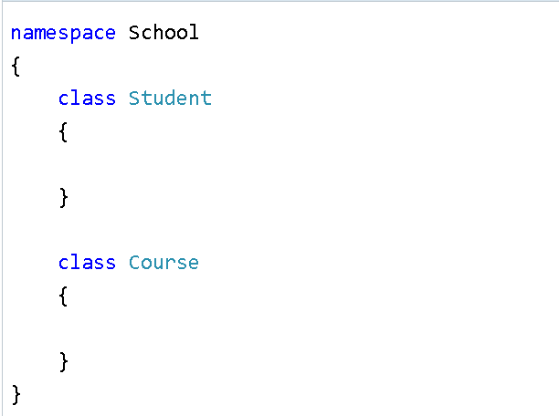
Namespaces
Namespaces are used in C# for organizing related classes
2 major namespaces in C#
DotNet framework namespaces
User-defined namespaces
A namespace is created for you when you create a new project (with the name of your project)
Classes under the same namespace can be referred to as namespace. classname syntax. For example, the Student class can be accessed as “School.Student”

Slide 6
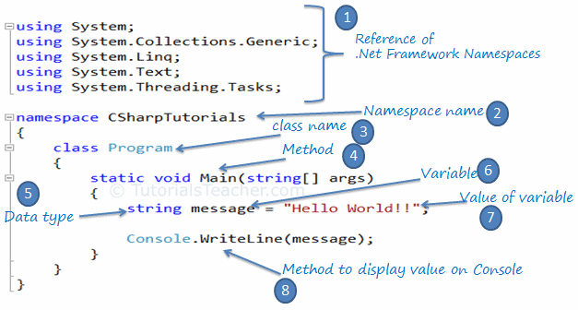
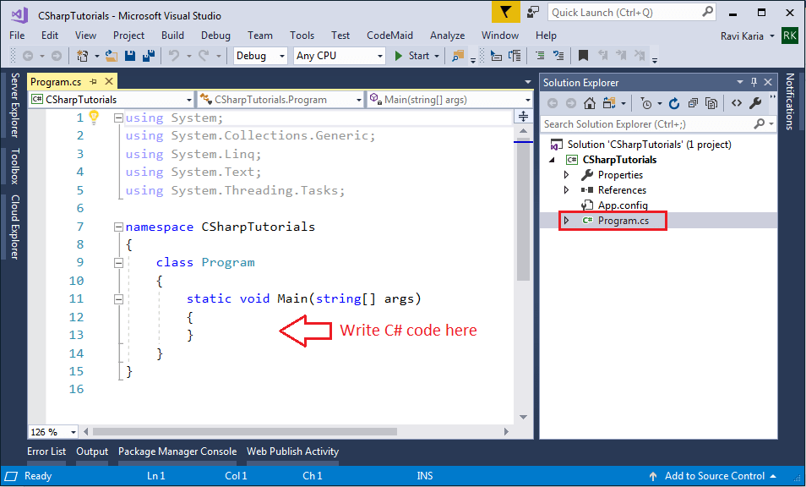

Slide 7
Implicitly Typed Variables
Local variables can be declared with var
Ex. var i = 5;
It could also be used when creating new objects
Ex.
DateTime time = new DateTime()
and
var time = new DateTime()
Do we really need to have DateTime in 2 places?
The C# compiler will infer the type from the right part of the statement. Hence, a value must always be assigned to the variable

Slide 8
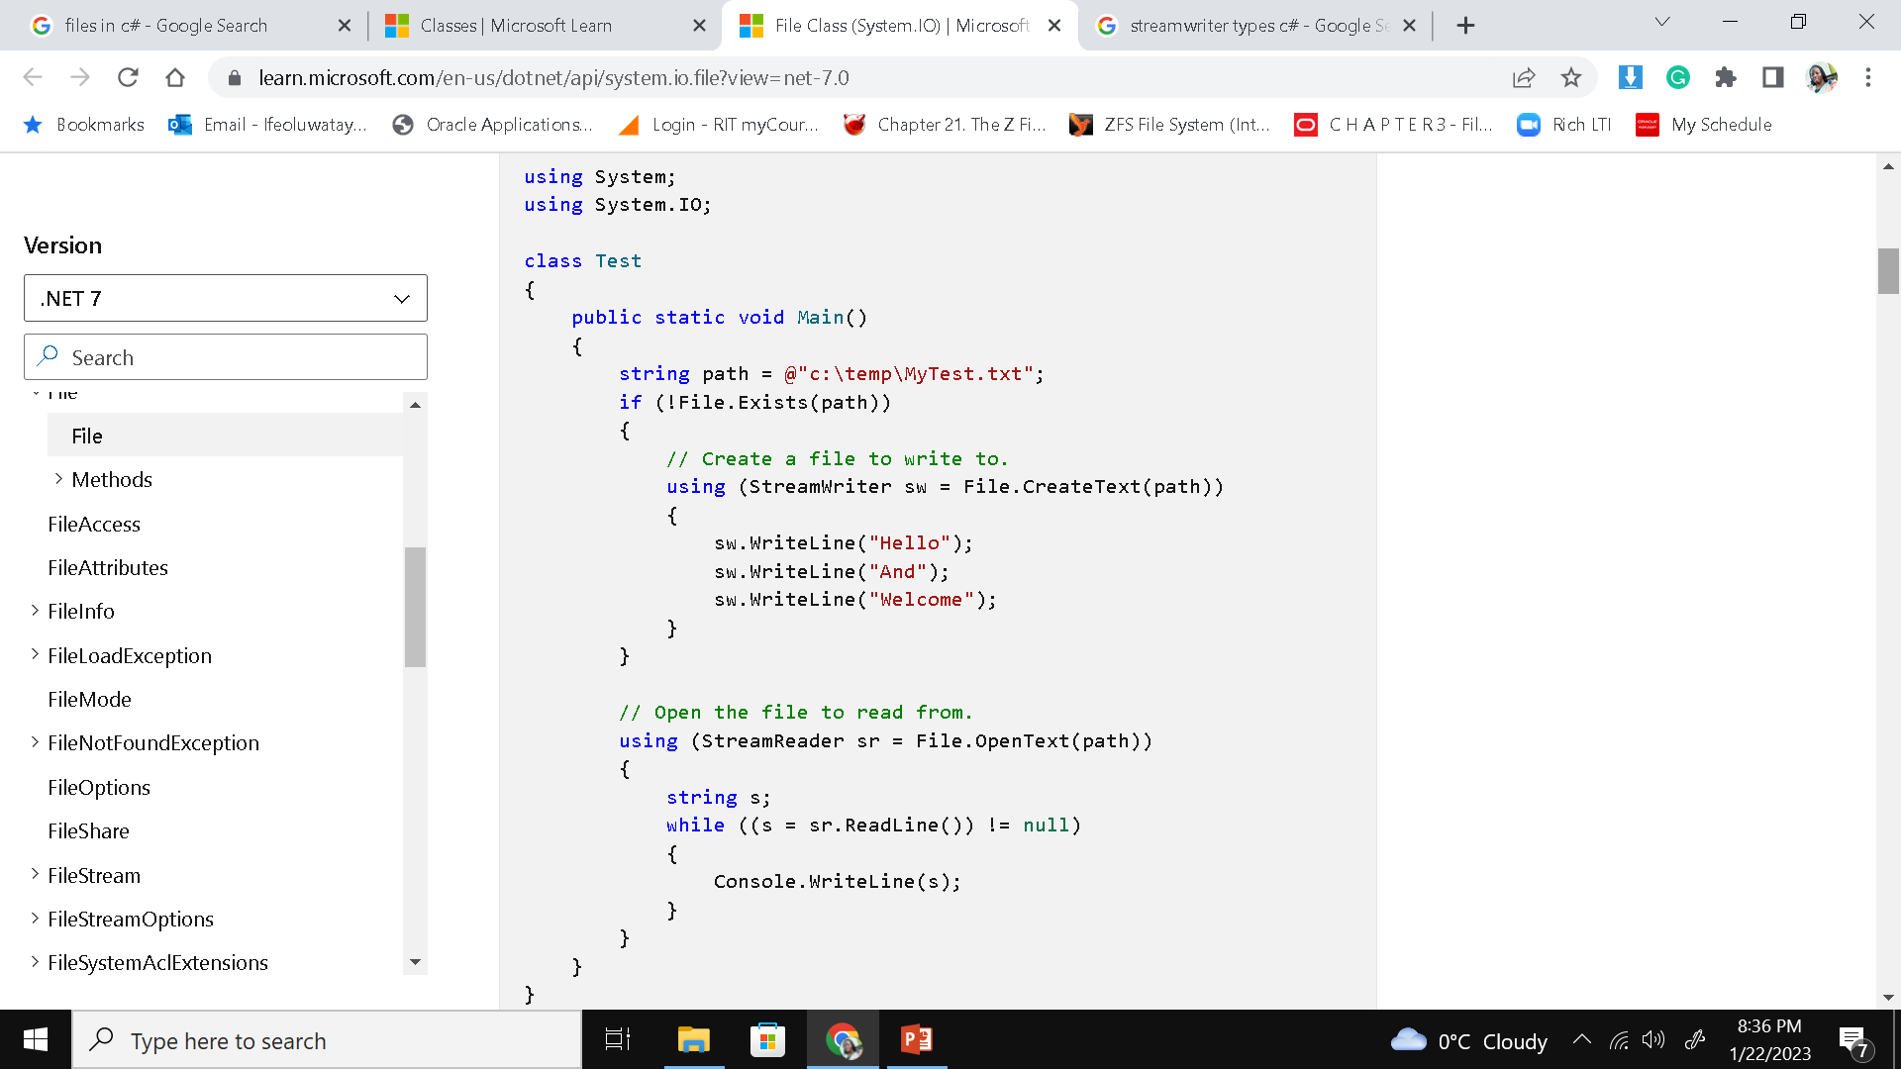
Accessing Files
File is a static class that provides different functionalities
copy, delete, check if a file exists, append lines or text to a file's content, get last access time, etc
Namespace is System.IO
StreamWriter and StreamReader classes could also do reading and writing.
Works equally well on Linux/Mac/Windows
Can handle any file format.
See Accessing_Files folder for code.
The using statement defines a scope at the end of which an object is disposed.
The using directive imports types defined in other namespaces.
using (StreamWriter sw = new StreamWriter(path))

Slide 9
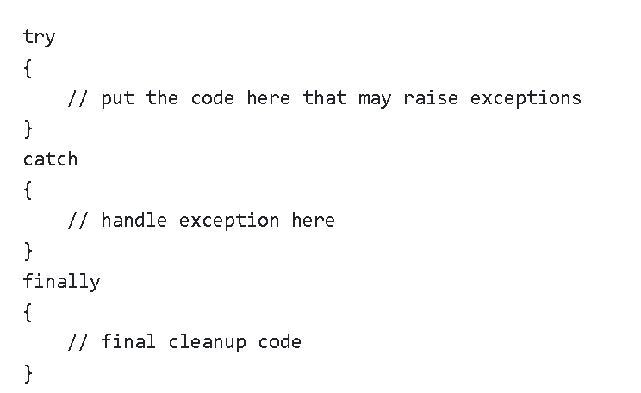
Exception Handling
C# provides built-in support to handle the exception using try, catch & finally blocks
Any suspected code that may raise exceptions should be put inside a try block
Catch identifies and catches specific exceptions such as Array Index Out Of Range or FileNotFoundException
The finally block will always be executed whether an exception is raised or not.
Is used to release resources, e.g., to close any stream or file objects that were opened in the try block
A try block without a catch or finally block causes a compiler error.

Slide 10
Networking in C#
System.Net and System.Net.Sockets namespaces are used for networking programming in C#
System.Net has very robust classes such as DNS, HttpListener, IPEndPoint etc.
Will learn more in week 6 and 7.

Slide 11
Code Sample 1:“Example 0”
Hello world
Created with dotnet new console
Run with “dotnet run” in directory with .csproj and Program.cs file
Prints hello world to the console

Slide 12
Code Sample 2: “Example 1”
Gets a directory listing of the current directory
Prints out file information
Size
Last Write Time
Filename

